Slide 1
PROJ 216 Software Project Concepts
Day 4

Slide 2
Topics
Agile Software Development
UML Use Case Diagram
User Experience (UX)

Slide 3
“There is nothing permanent except change.”
— Heraclitus

Slide 4
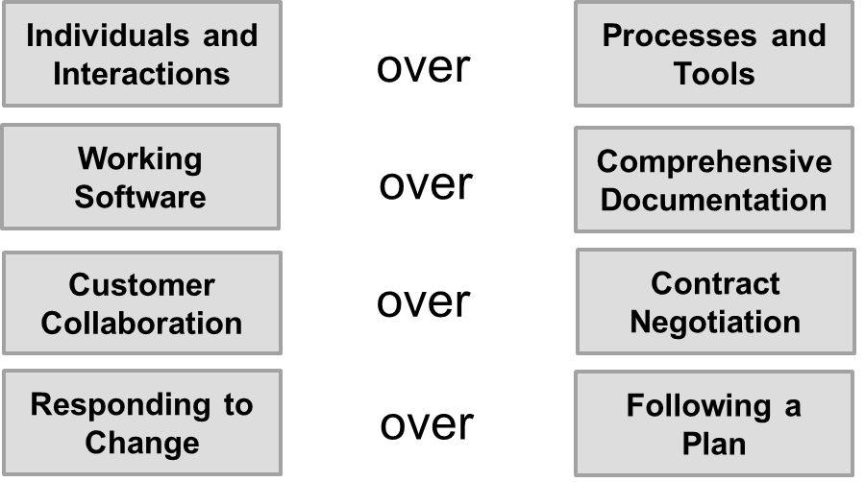
Agile Manifesto
The term “Agile” was created in 2001 – an effort to establish principles of a better approach to software development:
https://www.agilealliance.org/agile101/the-agile-manifesto/

Slide 5
12 Principles of Agile (1)
https://www.agilealliance.org/agile101/12-principles-behind-the-agile-manifesto/
Customer satisfaction is always the highest priority and is achieved through rapid and continuous delivery.
Changing environments are embraced at any stage of the process to provide the customer with a competitive advantage.
A product or service is delivered with higher frequency.
Stakeholders and developers collaborate closely on a daily basis.

Slide 6
12 Principles of Agile (2)
All stakeholders and team members remain motivated for optimal project outcomes, while teams are provided with all the necessary tools and support and are trusted to accomplish project goals.
Face-to-face meetings are deemed the most efficient and effective format for project success.
A final working product is the ultimate measure of success.
Sustainable development is accomplished through agile processes whereby development teams and stakeholders are able to maintain a constant and ongoing pace.

Slide 7
12 Principles of Agile (3)
Agility is enhanced through a continuous focus on technical excellence and proper design.
Simplicity is an essential element.
Self-organizing teams are most likely to develop the best architectures and designs and to meet requirements.
Regular intervals are used by teams to improve efficiency through fine-tuning behaviors.

Slide 8
Agile Software Development
Agile is the ability to respond to change and adapt
Great in the presence of unclear requirements
Can be applied to software development, project management, and more
Agile software development approach emphasizes incremental delivery, team collaboration, continual planning, and continual learning
https://www.visual-paradigm.com/scrum/what-is-agile-software-development/
https://www.agilealliance.org/agile101/

Slide 9
Scrum
One of the frameworks under Agile development umbrella, focused on iteratively/ incrementally developing and delivering complex products of highest possible value
Knowledge comes from experience, and decision making is based on what is currently known
Scrum Team: Product Owner, Development Team, Scrum Master
Uses short development cycles called Sprints (1 week to 1 month)
Scrum events:
Sprint Planning
Daily Scrum
Sprint Review
Sprint Retrospective

Slide 10
From User Stories to Product Backlog
User stories – the work to be done divided into functional units
Order does not matter, “game pieces”
A collection of user stories forms the Product Backlog
Responsibility to maintain product backlog belongs to the Product Owner – single point of responsibility
Product Owner can be someone from the Scrum Team or representative of the client on site
Assigns priorities to product backlog items
Identifies item for the next sprint and can cancel current sprint
Accepts completion of the backlog item
Question: What can product owner do if an item is not completed in the current sprint?

Slide 11
Development Team and Scrum Master
Development Team is self-organizing, cross-functional; no fixed roles for individual members
No sub-teams; accountability belongs to the team as a whole
Small size, typically not more than 10, excluding Scrum Master an Product Owner
Scrum Master – coaches the Development Team, facilitates scrum events, assists Product Owner

Slide 12
Sprint Planning
Meeting of the Scrum Team at the beginning of a Sprint ( a few hours)
Facilitate by Scrum Master
Objectives:
What can be done this Sprint? Product Owner presents item from the Product Backlog. Sprint Goal – an objective set for the Sprint to implement the identified Product Backlog item
For larger projects, create a Sprint Backlog
How will the chosen work be done? Clarify common understanding of the “Done”
Development Team self-organizes
Work to be done in the first few days decomposed into units of one day or less

Slide 13
Daily Scrum
At the beginning of each day, 15-minute meeting of the Development Team
Held daily, at the same time and place
Standing
Scrum Master ensures meetings takes place, but the Development Team is responsible for conducting it
Plan work for the next 24 hours
Questions to answer:
What did I do yesterday?
What will I do today?
Did I encounter or do I anticipate any problems?

Slide 14
Sprint Review
Held at the end of the Sprint
The Scrum Team and stakeholders collaborate about what was done in the Sprint and what could be the next steps to optimize value
Informal meeting rather than status meeting; presentation focused on soliciting feedback
Product Owner discusses the current state of the Product Backlog
The entire group collaborates on what to do next – input for the next Sprint Planning
Review of the timeline / budget

Slide 15
Sprint Retrospective
Occurs after the Spring Review and before the next Sprint Planning
A opportunity for the Scrum Team to inspect itself and create a plan for improvements
How the last Sprint went in regards to people, relationships, process, and tools
Identify major items that went well and potential improvements
Create a plan for implementing improvements to the ways the Scrum Team does the work
The Scrum Master ensures that the meeting is positive and productive

Slide 16
Extreme Programming
Extreme Programming (XP) is a software development methodology that aims at improved software quality and responsiveness to changing customer requirements
Common practices:
Writing unit tests before programming
Starting with a simple design and redesigning when required
Pair programming
Integrating and testing often
Putting minimal working system into production quickly and upgrading whenever required
Keeping the customer involved and obtaining feedback
https://www.tutorialspoint.com/extreme_programming/extreme_programming_introduction.htm

Slide 17
What is a Use Case
Oxford Dictionary definition: use case is a specific situation in which a product or a service could potentially be used
A list of actions or steps defining interaction between a role ( actor – a human or external system) and a system to achieve a goal
Use case captures major part of system’s functionality
Describes how user uses the system to accomplish a particular goal

Slide 18
Unified Modeling Language (UML)
Modeling method consists of:
Language (notation)
Process (sequence of steps to perform)
Tool (software)
UML is the standardized visual object-oriented modeling language (diagrams)
1997 – UML becomes industry standard
2015 – UML 2.5
https://www.omg.org/spec/UML/2.5/About-UML

Slide 19
UML Diagrams
Use Case Model – captures user’s perspective
Use case diagrams
Logical Model
Structure of the system
Class diagrams, package diagrams
Behaviour of the system
Sequence diagrams, collaboration diagrams, state transition diagrams, activity diagrams, …
Physical Model
Component diagram (software)
Deployment diagram (hardware)

Slide 20
Use Case Diagram
Use case diagram identifies actors and use cases, and their relationships
Analyze requirements of a system
Visualize system design at a high-level
Capture major pieces of system’s functionality

Slide 21
Elements of Use Case Diagrams
Use Cases – top-level items of system functionality from the users’ point of view
Withing system’s boundary
Labeled with verb-noun phrase
Actors – roles (people or other systems) that interact with our system
External to the system
Relationships

Slide 22
Relationships in Use Case Diagrams
Association
Links an actor to the use case(s) with which it interacts
Relationships between two use cases
Include
Extend
Generalization
Relationships between two actors are not modeled (irrelevant – outside of the system)

Slide 23
Extend vs. Include
Extend – one use case is an optional extension on another use case
Add to Favourites is an optional extension of Browse Products
Include – one use case is a necessary (mandatory) part of another use case
Process Payment is a necessary part of Buy Products
The relationship annotation <<extend>> and <<include>> reads in the direction of the arrow

Slide 24
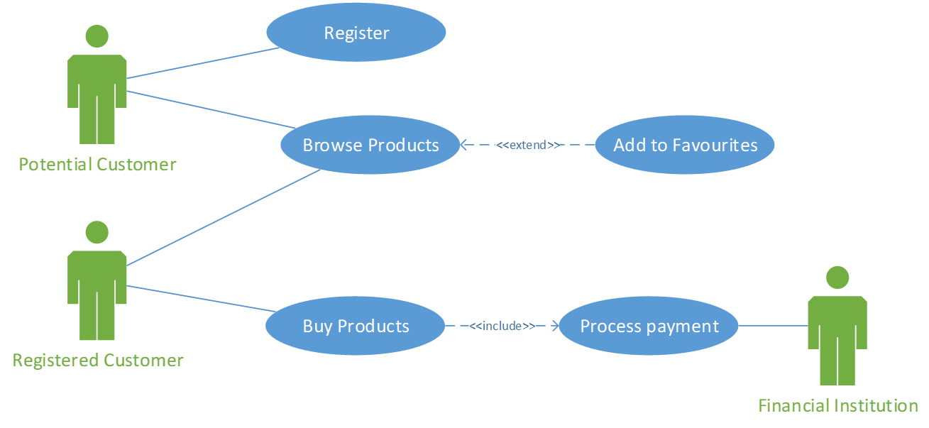
Example o Use Case Diagram

Slide 25
MS Visio Demo
Create an UML Use Case diagram

Slide 26
Group Exercise
30 minutes
Create use case diagram a well-known system, like Wikipedia, Amazon, Twitter, …

Slide 27
Documenting Use Cases
Use Case Description
No standard format
Typical elements:
Use case name (verb-noun phrase)
Who interacts with it (actors)
What triggers it
Flow of events – a possible sequence of steps through the use case execution
Normal flow of events
Sub-flows (break it down to simplify description)
Exceptional flows

Slide 28
User Experience
“User experience (UX) focuses on having a deep understanding of users, what they need, what they value, their abilities, and also their limitations. It also takes into account the business goals and objectives of the group managing the project.”
User Experience Basics

Slide 29
UX Best Practices
30 minutes
In groups, research UX best practices

Slide 30
Work on Assignment 3 Part 2 – Use case Diagram

